Slide 1
Amazon Echo
Xu Zhou

Slide 2

Background
First launch: 2014
Competition
Questions:
What do customers say?
Anything to improve?

Slide 3
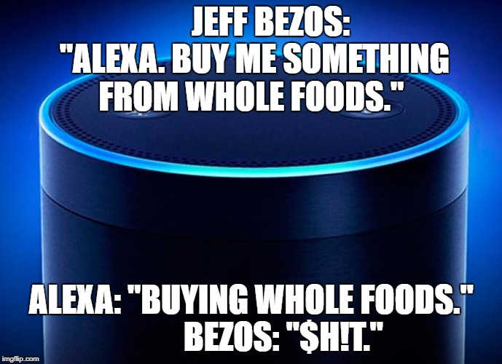
Approach
Data: ~10K reviews
Cluster Analysis
Topic Modeling

Slide 4
Customer Compliments

Slide 5
Customer Compliment #1
-Smart

Slide 6
Customer Compliment #2
-Easy to Use

Slide 7
Customer Compliment #3
-Best Gift Option

Slide 8
Customer Complaints

Slide 9
Customer Complain #1
-Connection Issue

Slide 10
Customer Complain #2
-Speaker Issue

Slide 11
Customer Complain #3
-Customer Service

Slide 12

Summary
Key Strengths:
Smart
Simplicity
Best Gift Option
Key Areas to Improve:
Connection
Speaker
Customer Service

Slide 13
Key Take-away
Listen to and understand customers,
or…

